Slide 1


Taxi Hotspot Clustering and Proximity Recommendation system
Post Graduate Diploma in Big Data Analytics (PG-DBDA)
March 2023 Batch
Group No. 1
Project Team Members:
1. Monica Jha
2.Shivani Phuke
3.Lokesh Sali
Guided By:
Dr. Priyanka Jain

Slide 2
CONTENTS
Introduction
Problem Definition
Possible Solution
Scope of Work
Software Requirements
Algorithm Used
Workflow Diagram
Model Training Glimpse
Generated Output
Future Scope

Slide 3

Introduction
The project is about finding the number of hotspots feasible for taxis in a city, where there is highest possibility of getting a taxi.
Using this the business can actually report the waiting hotspots to be made so that customers can go to these hotspots to get a taxi booked.
The project can be further extended as an application, where on the basis of customers current latitude and longitude, the model can recommend the nearest hotspot to them.

Slide 4

Problem Definition
People find it difficult to get taxis at their location and there are so many of them who wait too long for a taxi possibly cause:
taxi driver rejects the ride
or in city there are certain areas where taxi is not easily accessible
Hence its ideal to find a best service for customers.

Slide 5

Possible Solution
In order to ensure the taxi availability, we can create Hotspots/Waiting spots , just like bus stops, where people can reach at a dedicated point which has the highest possibility of getting a taxi
That’s where, our project “ Taxi Hotspot Clustering and proximity recommendation system” will provide a model where we try to predict the region/hotspot points where there is highest possibility of getting taxi in the city.

Slide 6
Scope of Work
The project is divided into following 2 phases:
Phase 1:
Collecting pickup and drop off points data for a city of a year and preprocessing it as per the need.
Once the data is ready, we will be using the concept of K means clustering to train the model so that, it can first map out the Regions where the waiting points can be created.
After the regions are mapped out, we can plot the Hot spots/waiting spots using centroids.
Phase 2:
Using this trained model, we can extend the application to predict the nearest Hotspot for the customer

Slide 7

Software Requirements
Machine Learning: Google Collab for generating model
Programming language: Python with libraries: NumPy, Pandas, matplotlib and seaborn for visualization.
Algorithm used: K means algorithm
Dataset source: Kaggle

Slide 8
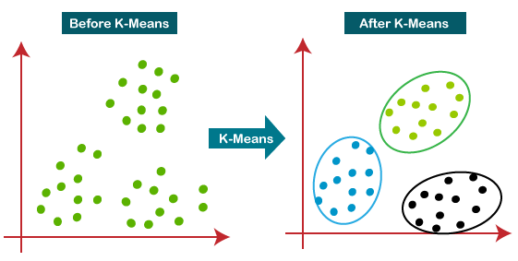
Algorithm Used
The project is based on k-means clustering algorithm
It basically assigns each data point to its closest k-center for predicting region of highest possibility of getting taxi.
Those data points which are near to the particular k-center, create a cluster and that cluster formed, is our Region.

Slide 9
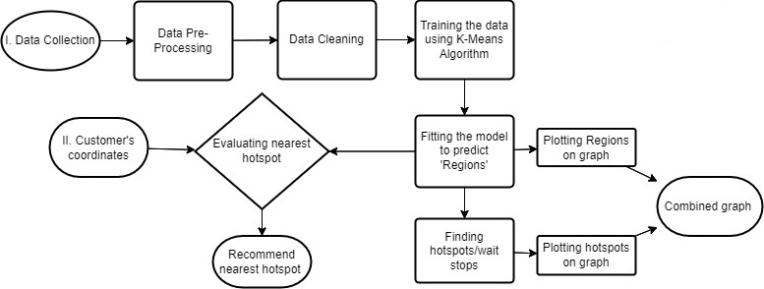
Workflow Diagram

Slide 10
Model Training Glimpse-Phase 1
Considering our cleaned and pre processed dataset as df_2015
Training the model on the basis of pickup latitude and longitude, combinedly called pickup_coordinates:
pickup_regions = KMeans(init='random').fit(pickup_coordinates)
Using a variable named "pickup_cluster_column" to predict the regions created.
pickup_cluster_column = pickup_regions.predict(df_2015[["pickup_latitude",pickup_longitude"]])
Using centroids concept, determining the hot spot or the waiting stop out of the regions created.
(pickup_regions.cluster_centers_)

Slide 11
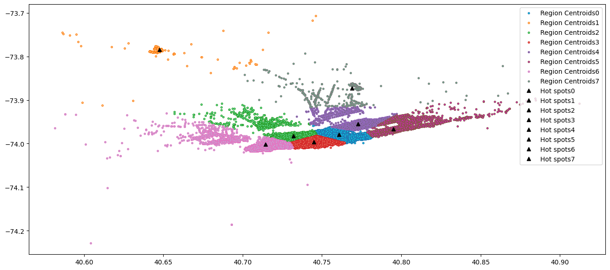
Generated Output- Phase 1
Graph showcasing the Regions with their hotspots/waiting stops.

Slide 12
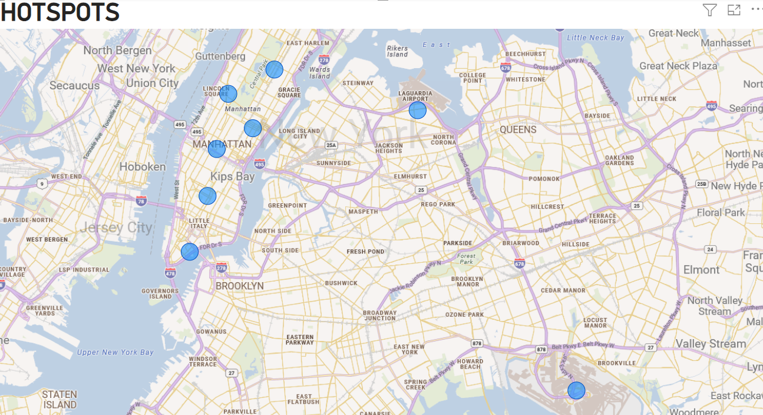
Generated Output- Phase 1 (Contd..)
Hotspots/waiting stops plotted on the city map using PowerBI

Slide 13
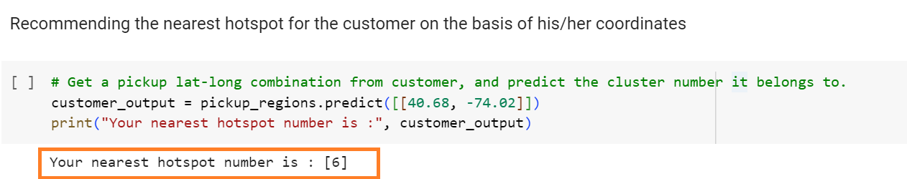
Generated Output- Phase 2
In phase 2, we have extended our project such that , on the basis of customer’s current latitude and longitude, the model will recommend him/her the nearest hotspot

Slide 14

Future Scope:
On the basis of this model :
We can build a web/ mobile application to locate real time hot spots for customers.
We can build a fare surcharge model for taxi companies to earn more profit on the basis of these hot spot regions.
The companies can also reversely use this model to identify the other regions which are not that highly in demand and root causes for it. So that they can increase pickups and install more waiting spots
Women who travel daily or especially at night time instead of taking taxi randomly, these hotspots are safe for taking a taxi.

Slide 15

THANK YOU !

